Slide 1
Diaphragm Pressure gauge using LVDT

Slide 2
The Diaphragm Pressure Gauge uses the elastic deformation of a diaphragm (i.e. membrane) to measure the difference between an unknown pressure and a reference pressure.
Diaphragm Pressure Gauge

Slide 3
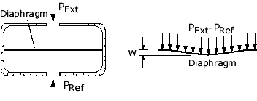
Diaphragm Pressure Gauge

Slide 4
Diaphragm Pressure Gauge

Slide 5
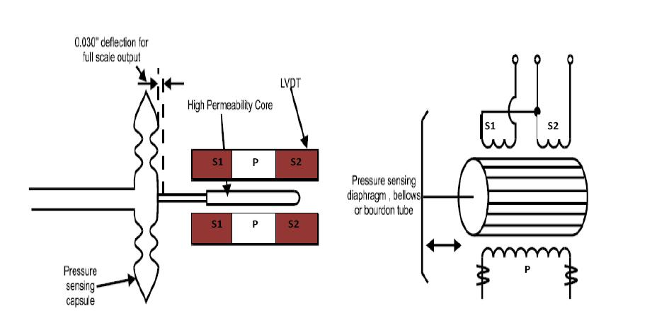
Diaphragm Pressure Gauge Using LVDT

Slide 6
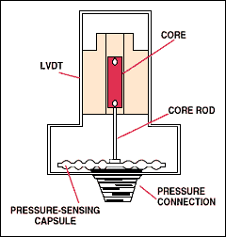
Diaphragm Pressure Gauge Using LVDT

Slide 7
Advantages
It gives high Output(No Amplifier required)
Sensitivity is Very High
Shows Low Hysteresis
Repeatability is Excellent
Consumes power less than 1 W
Less friction and Less noise
Tolerate high degree of shock
Operating Range(-265 to 600 degree centigrade)

Slide 8
Disadvantages
Sensitive to stray magnetic field.
Relatively large displacement required.
Affected by vibrations.
Dynamic response is limited

